Slide 1
JK flipflop, T flip flop

Slide 2
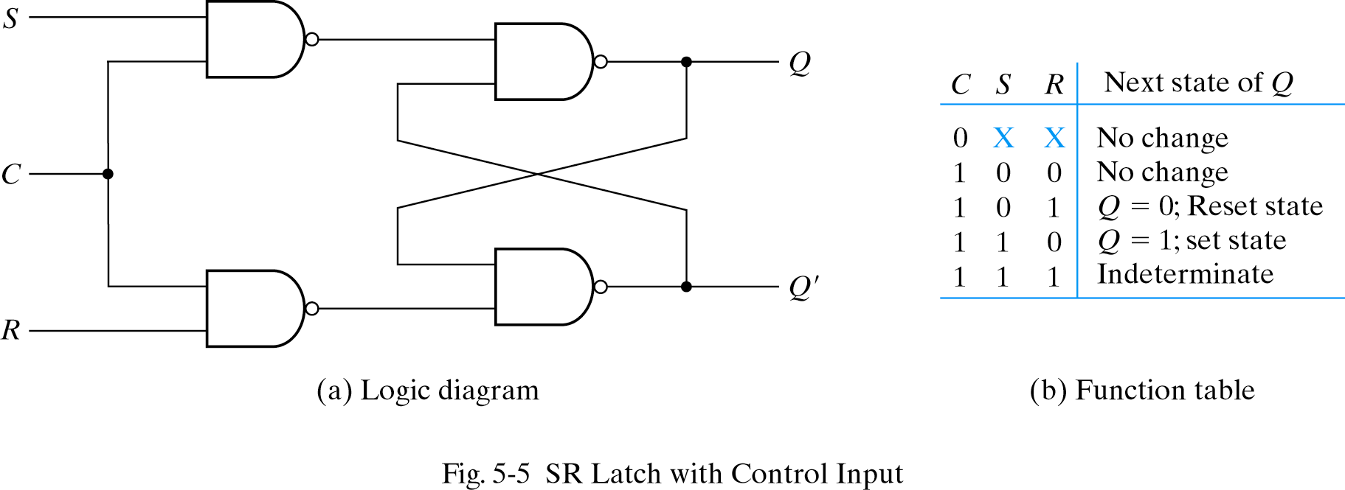
SR flip flop

Slide 3
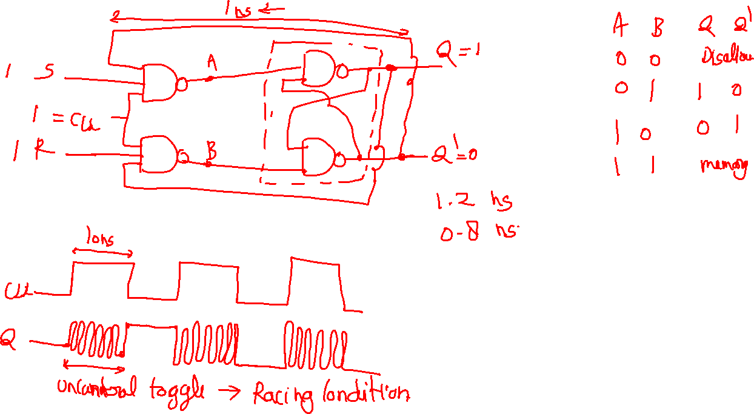

Slide 4
Race around condition

Slide 5
Master Slave

Slide 6
JK flip flop

Slide 7
T flip flop

